Slide 1

Project Title- Android Attendance System
Shri Shankaracharya Engineering College
Group Members
Harneet Singh
Divakar Banchhor
Ankit Adil
Guide Name
Manish Sahu

Slide 2
About-Android Attendance System
The mobile attendance system has been built to eliminate the time and effort wasted in taking attendance in schools and colleges.It also greatly reduces the amount of paper resourses needed in attendance data management . This is an android mobile app. It’s built to be used for college faculty so that they may take student attendance on their phones.

Slide 3

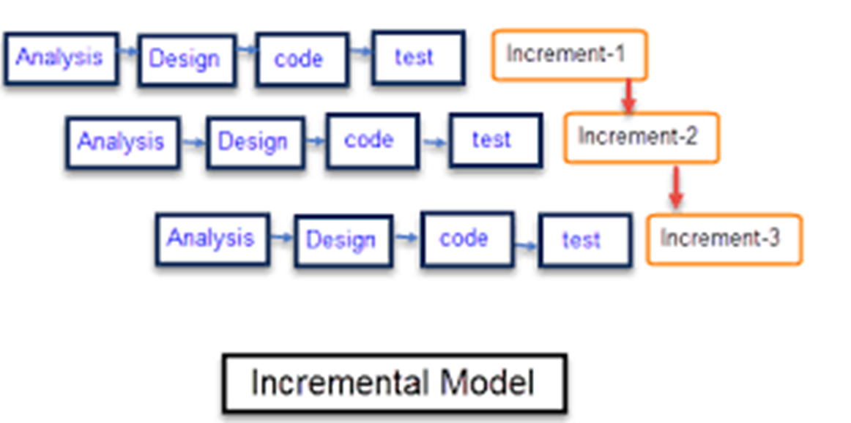
Project Model
Our project model is Incremental Model. The incremental model is a method of software development where the product is designed, implemented and tested incrementally until the product is finished.

Slide 4
FLOWCHART
START
LOGIN FORM
PROCESS USER ID,UNAME & PSWD
AUTHENTICATION
?
OPEN ADMIN PAGE
OPEN STUDENT PAGE
OPEN TEACHER PAGE
END
END
END

Slide 5

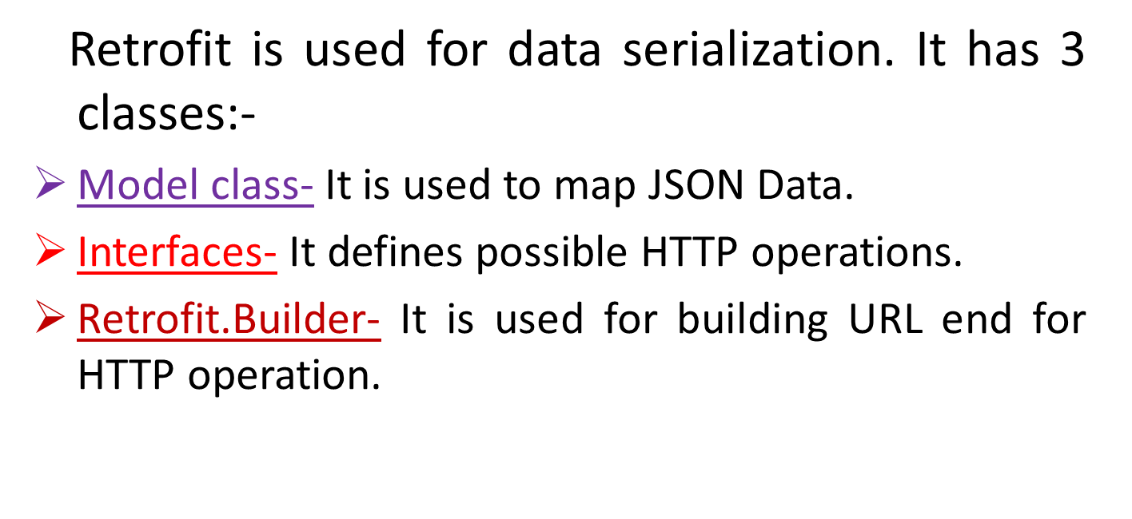
Sending and Recieving of data from server
Sending and receiving of data with server is done using Retrofit technique. Retrofit is Rest Client which is Representational State Transfer. In retrofit method the data which we have to send to the server is packed inside object or we can say that in retrofit method data is exchanged in the form of objects.

Slide 6
What is JSON
JSON stands for Javascript Object Notation.
It is an independent data exchange format.
{
“Students”:[
{
“Name”: “Harneet Singh”,
“College”: “SSEC”
},
{
“Name”: “Ankit Adil”,
“College”: “SSEC”
},
{
“Name”: “Divakar Banchhor”,
“College”: “SSEC”
}
]
}

Slide 7
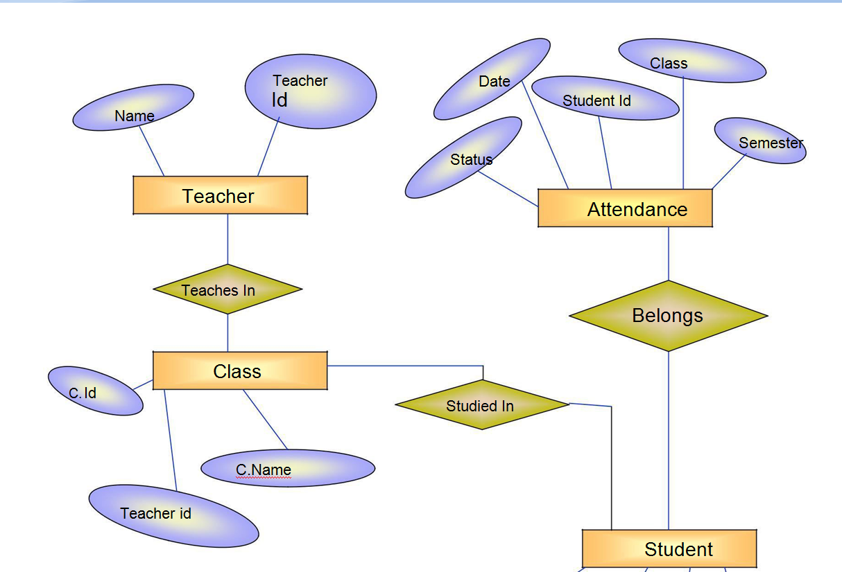
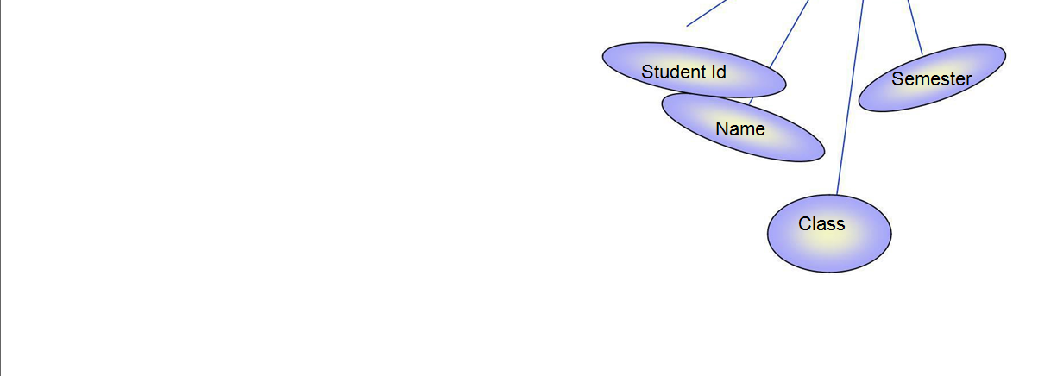
ER Diagram

Slide 8
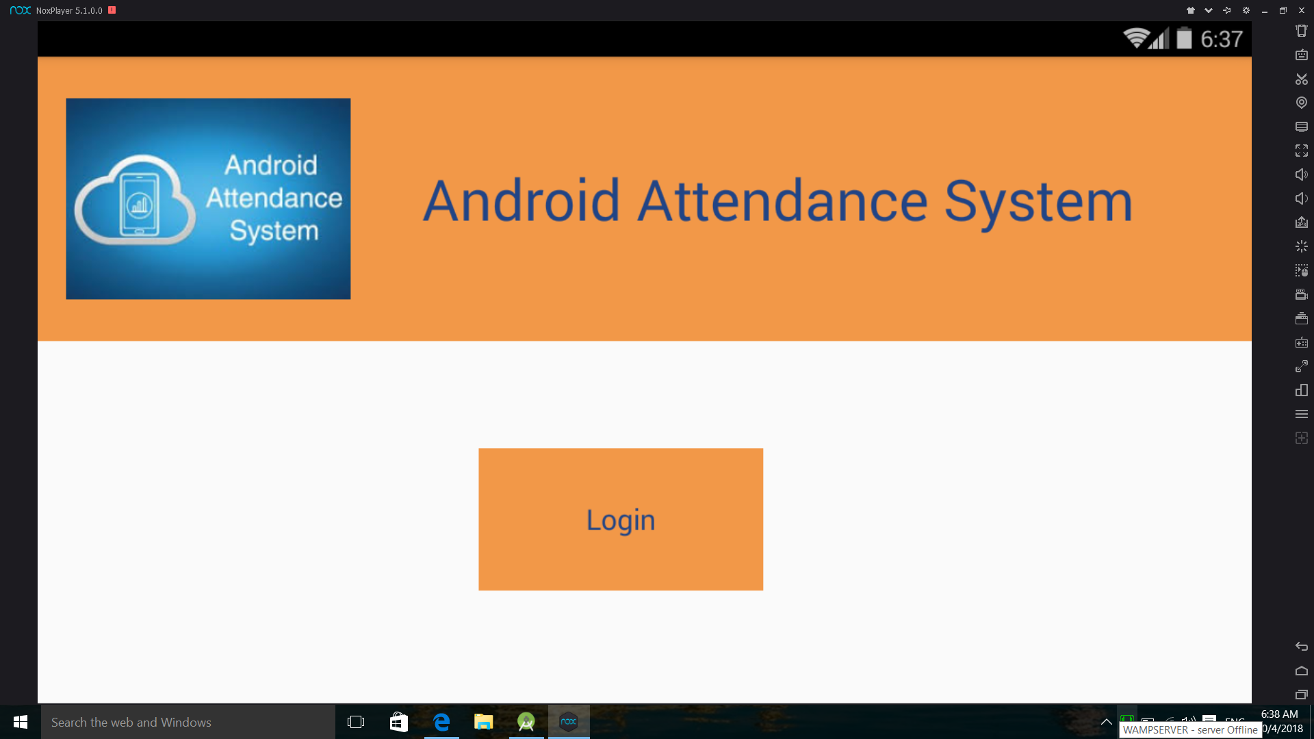
Initial Activity

Slide 9
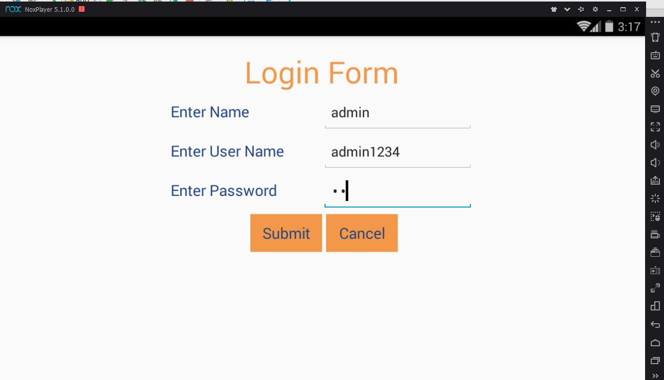
Login Activity

Slide 10
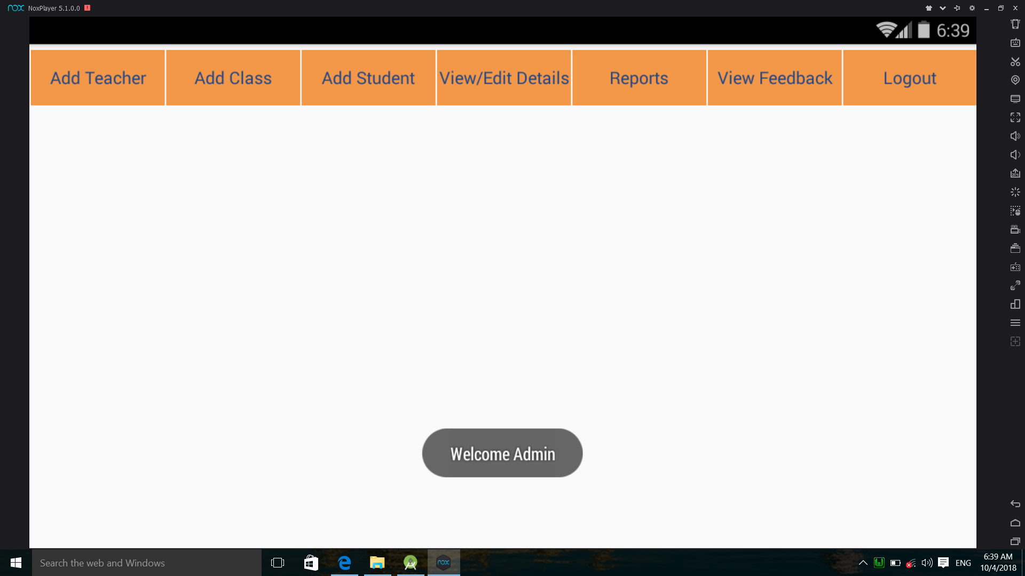
Admin Page

Slide 11
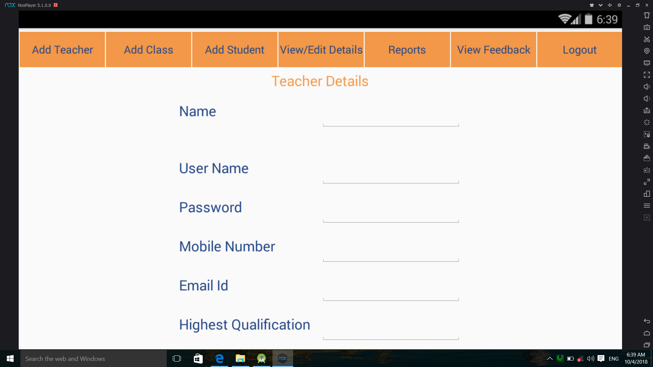
Admin Section Sub Modules

Slide 12
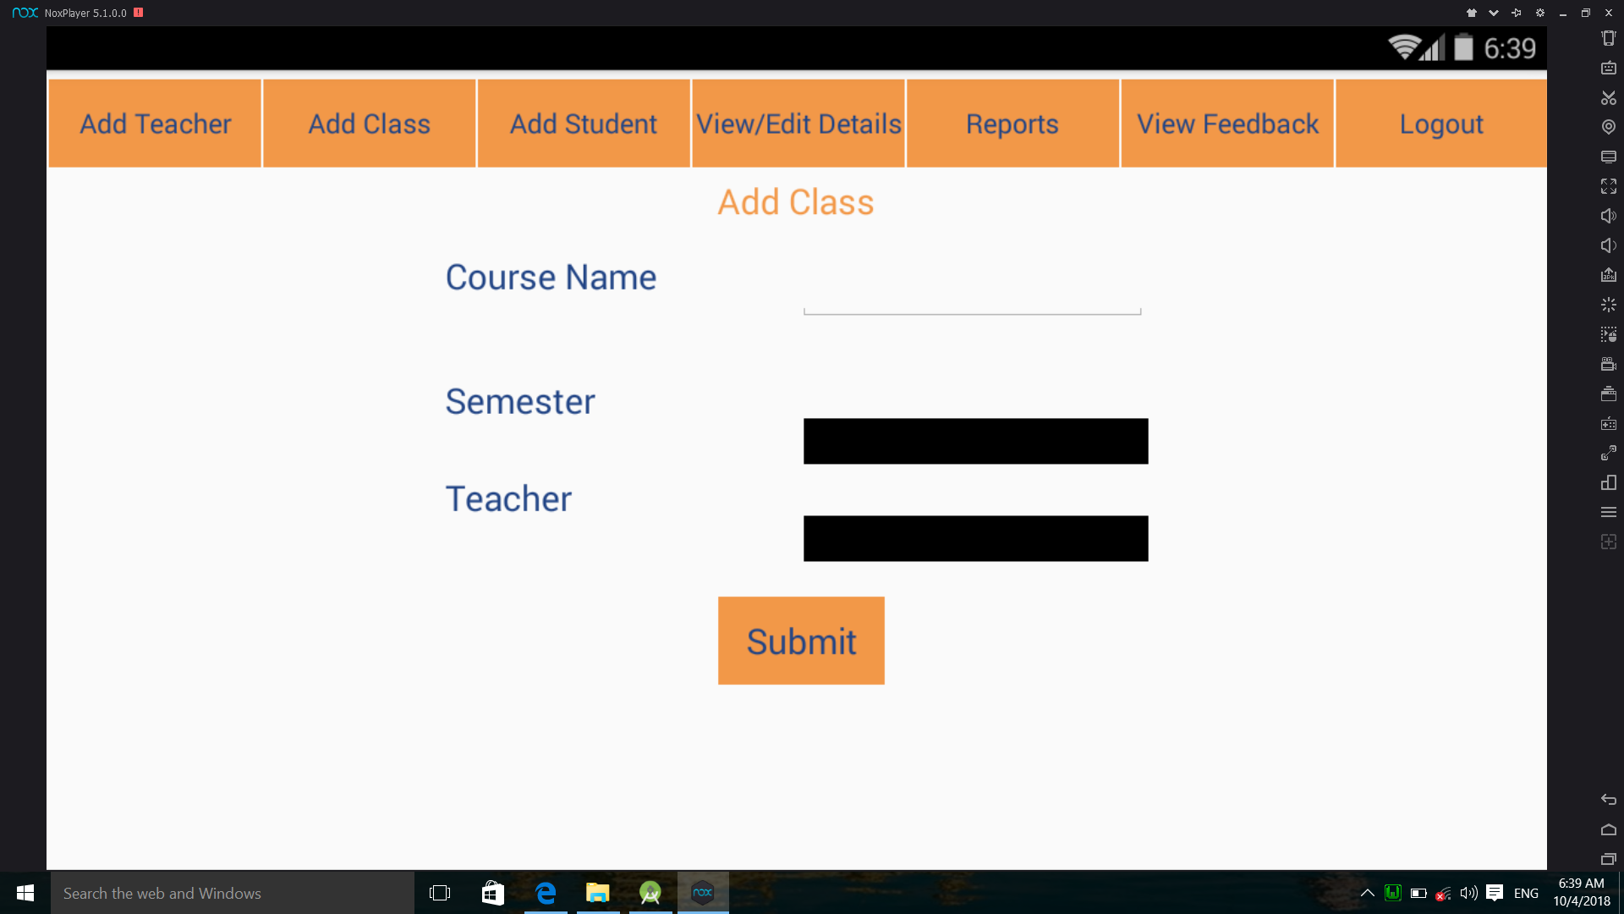
Add class

Slide 13
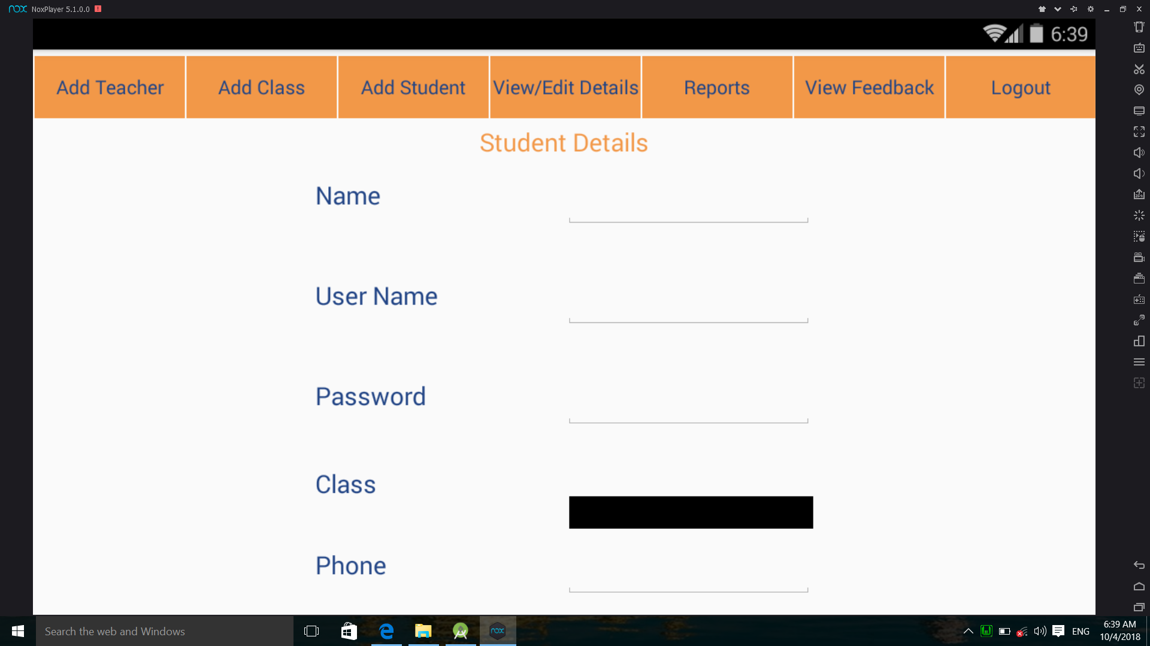
Add Student

Slide 14
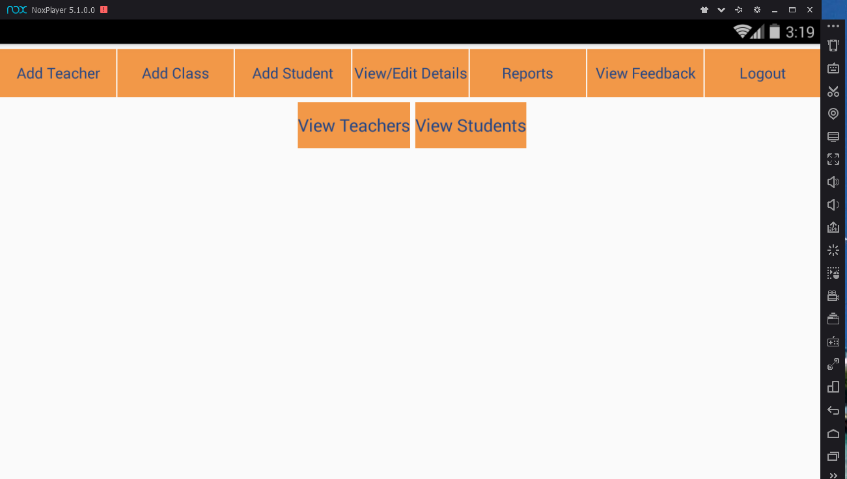
View Details

Slide 15
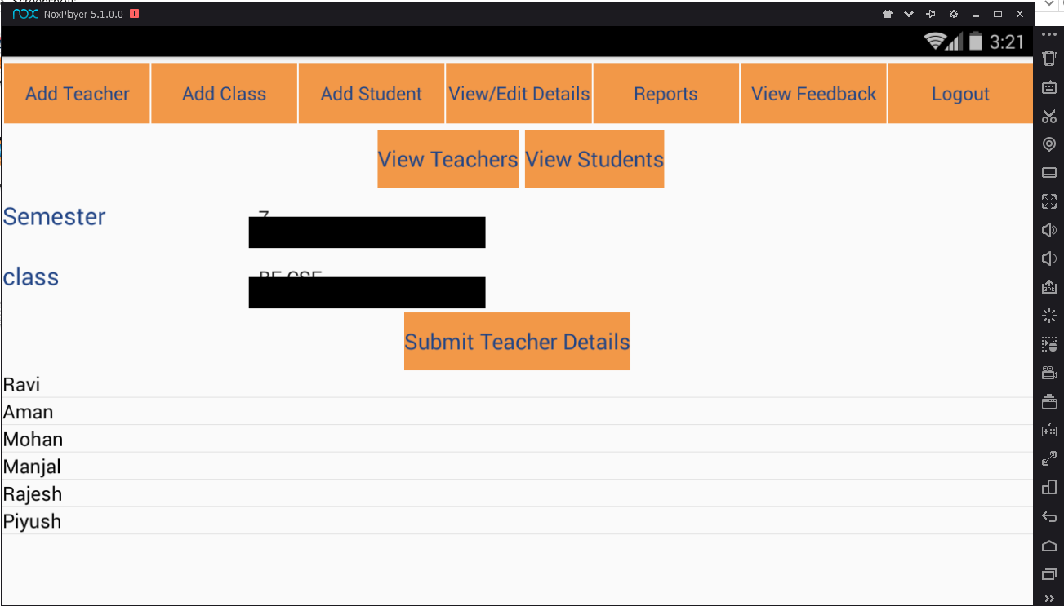
View Teacher Details

Slide 16

View Student Details

Slide 17
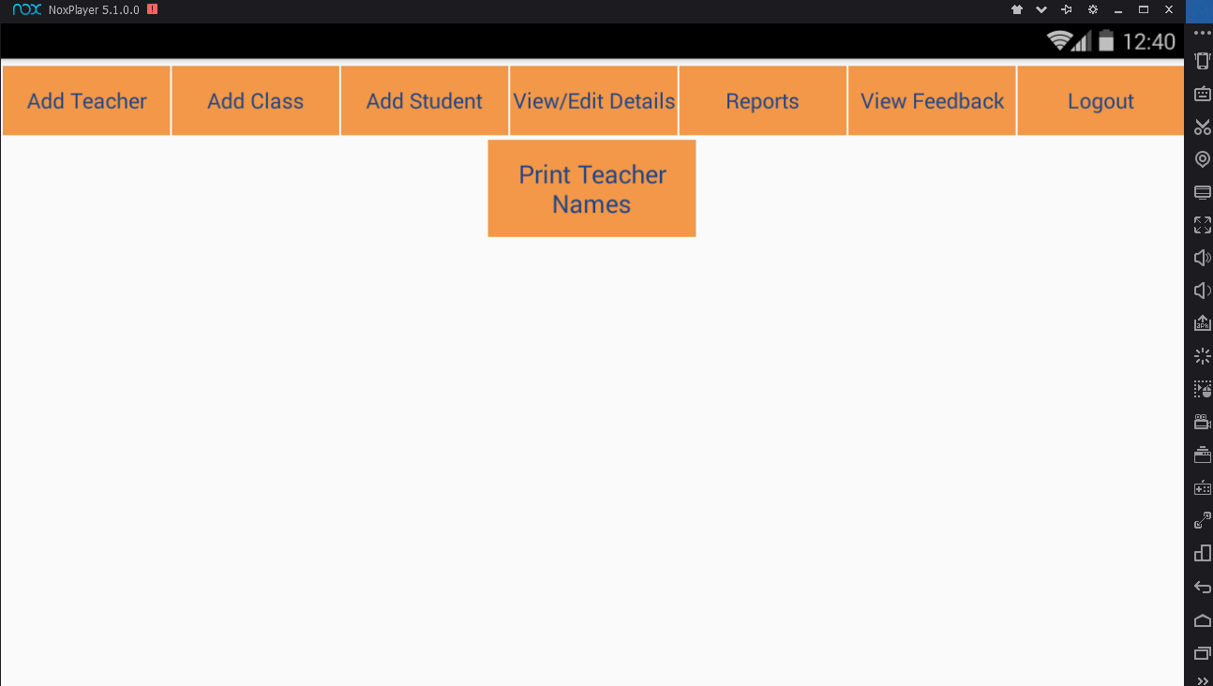
View Feedback

Slide 18
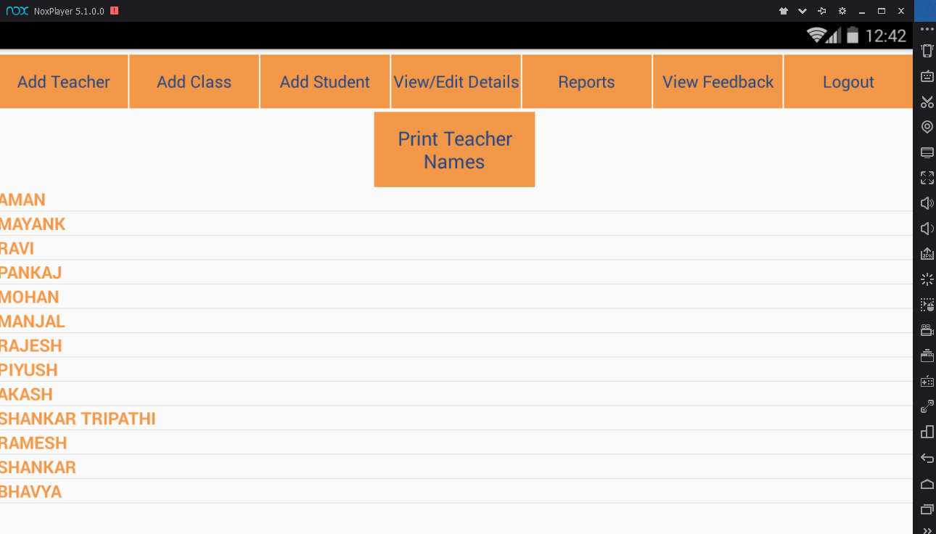
By clicking on “Print Teacher Names” button, all the names of teacher appears in list view. Now particular teacher name is taken to view feedback.

Slide 19
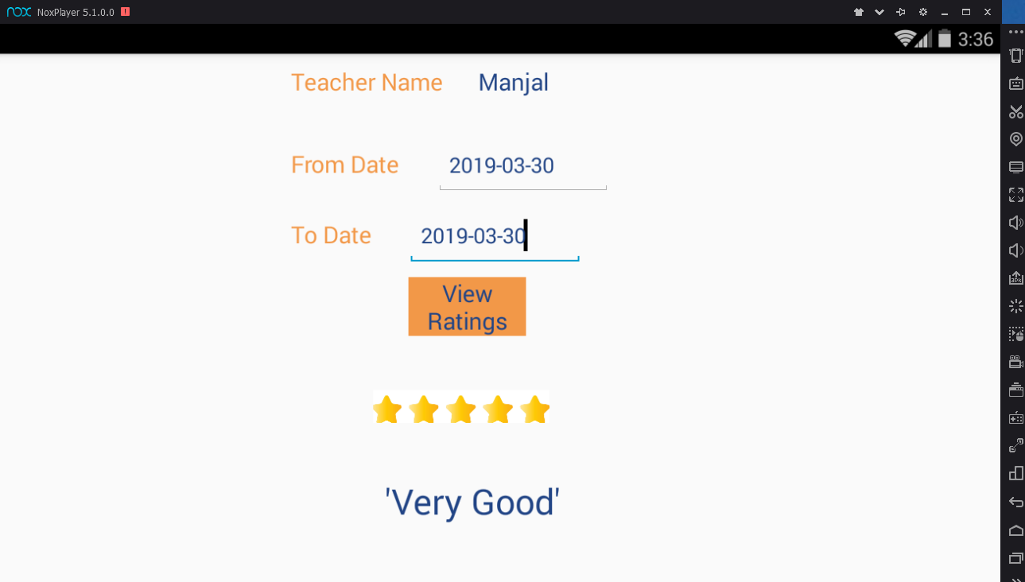
Now provide date to view feedback of teacher. Click on “View Ratings” button to view ratings.

Slide 20
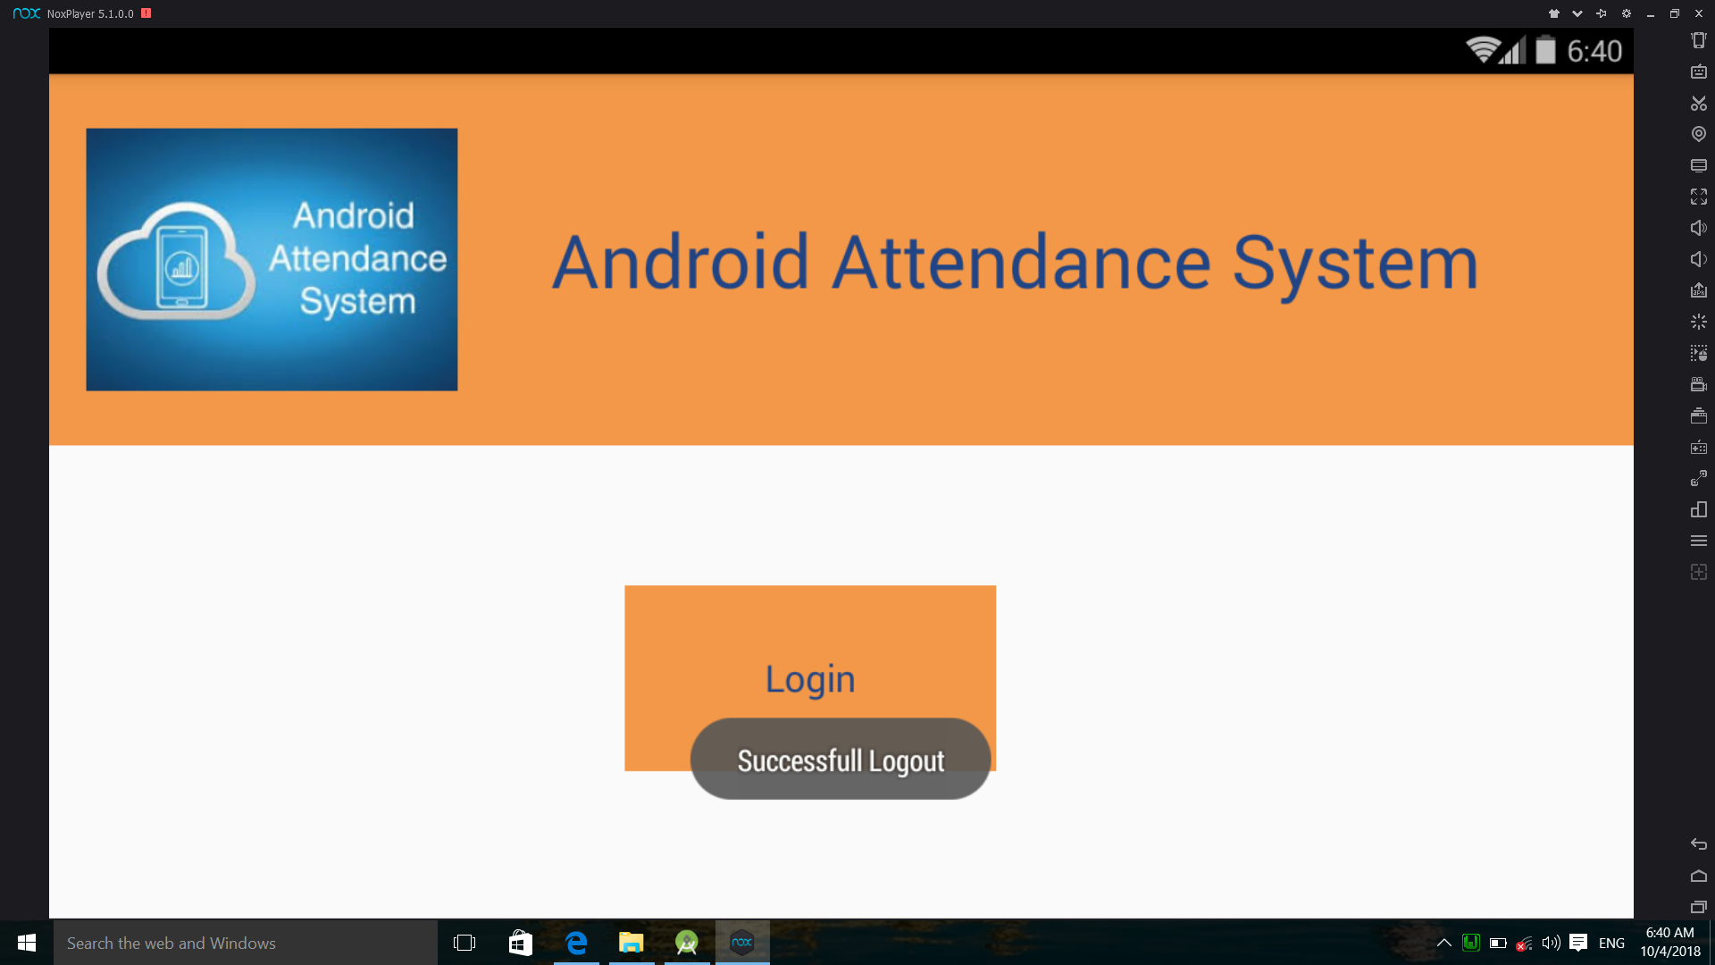
Logout Button

Slide 21
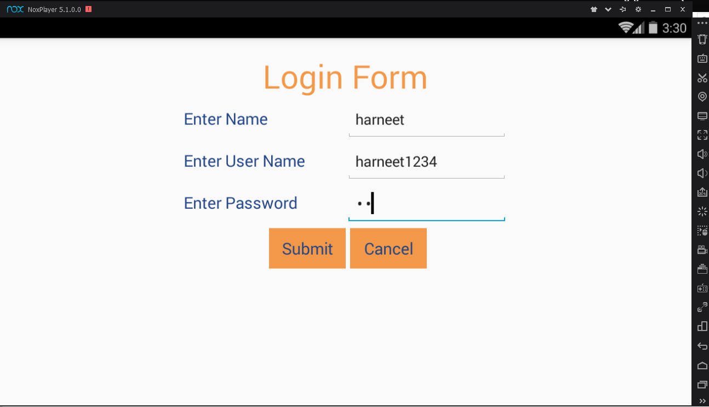
For Student Login

Slide 22
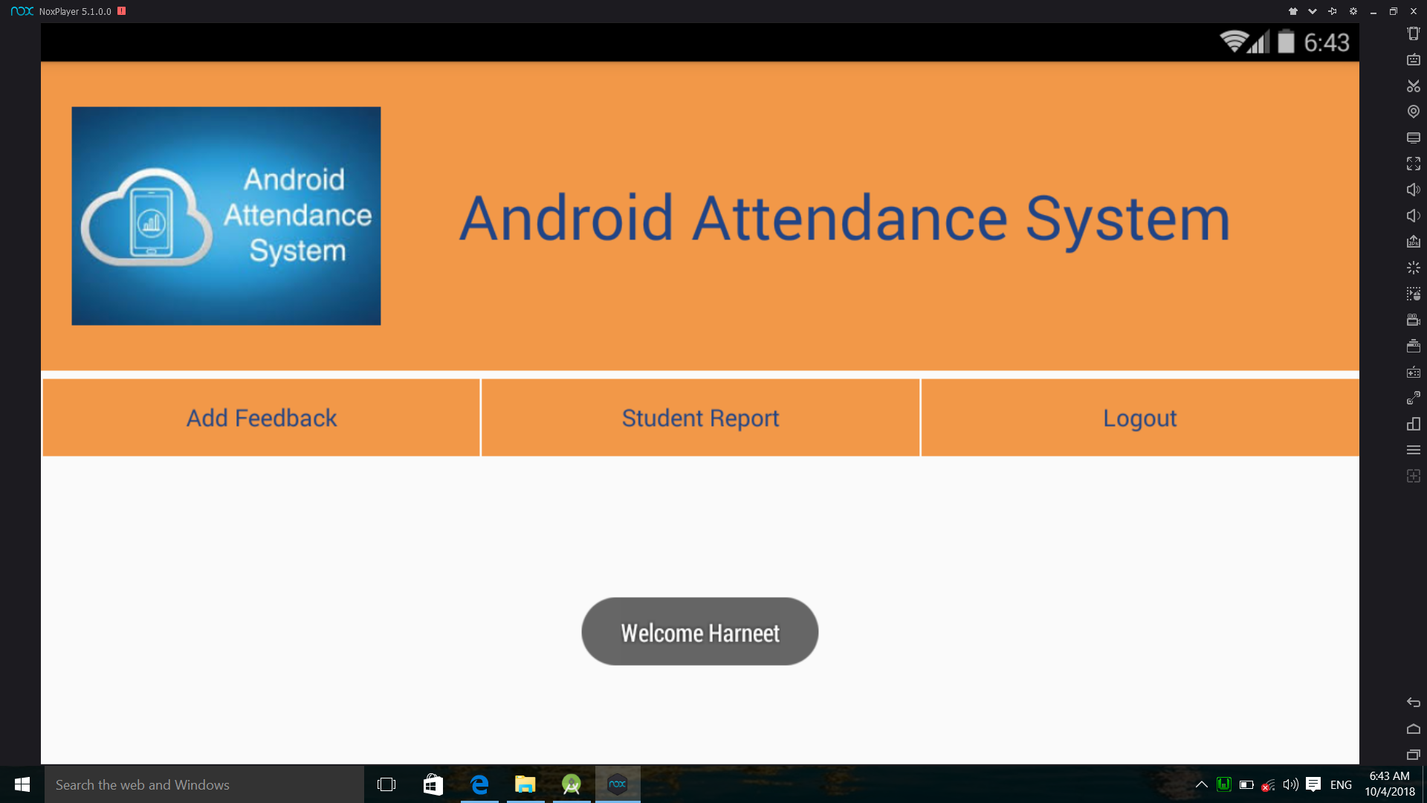
After Login

Slide 23
Feedback Section
When clicking on AddFeedback button a list of teachers will be generated.
Now by clicking on teacher name alert box will appear which will contain two buttons Save and Cancel.
By clicking Save button list will be saved to database directly.
And the feedback is visible to Admin.

Slide 24
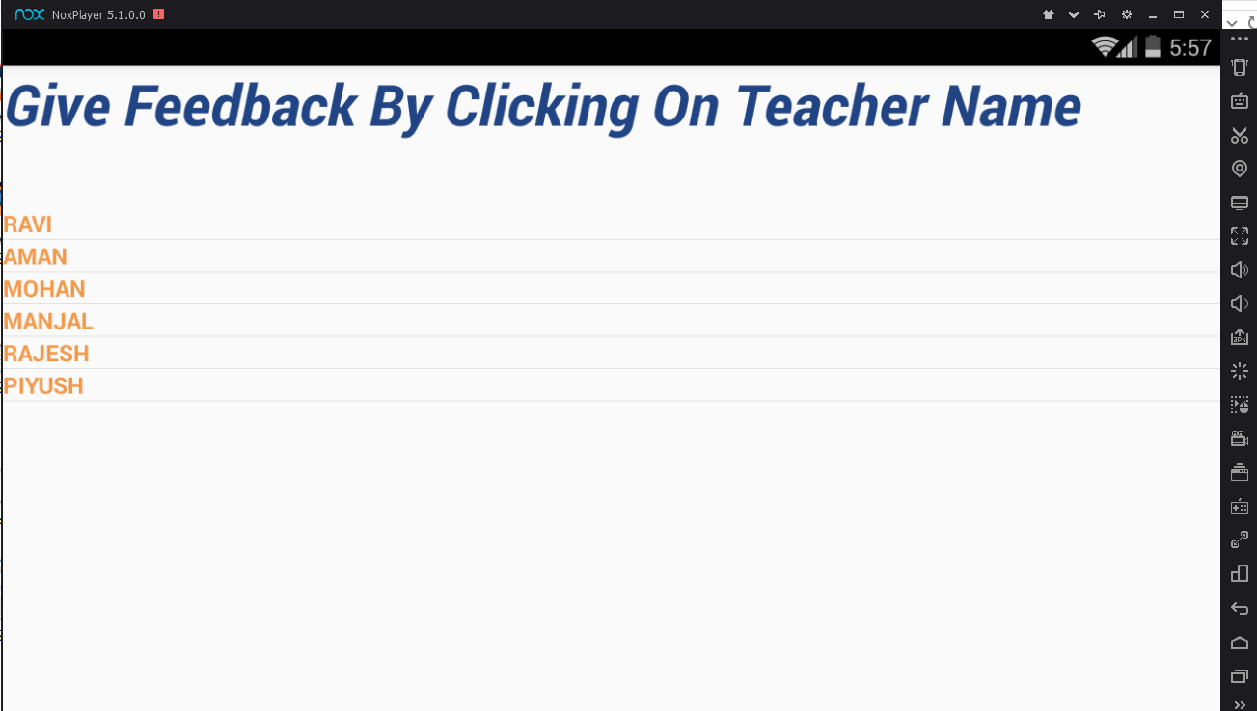
By clicking on teacher names Alert Box will appear.

Slide 25
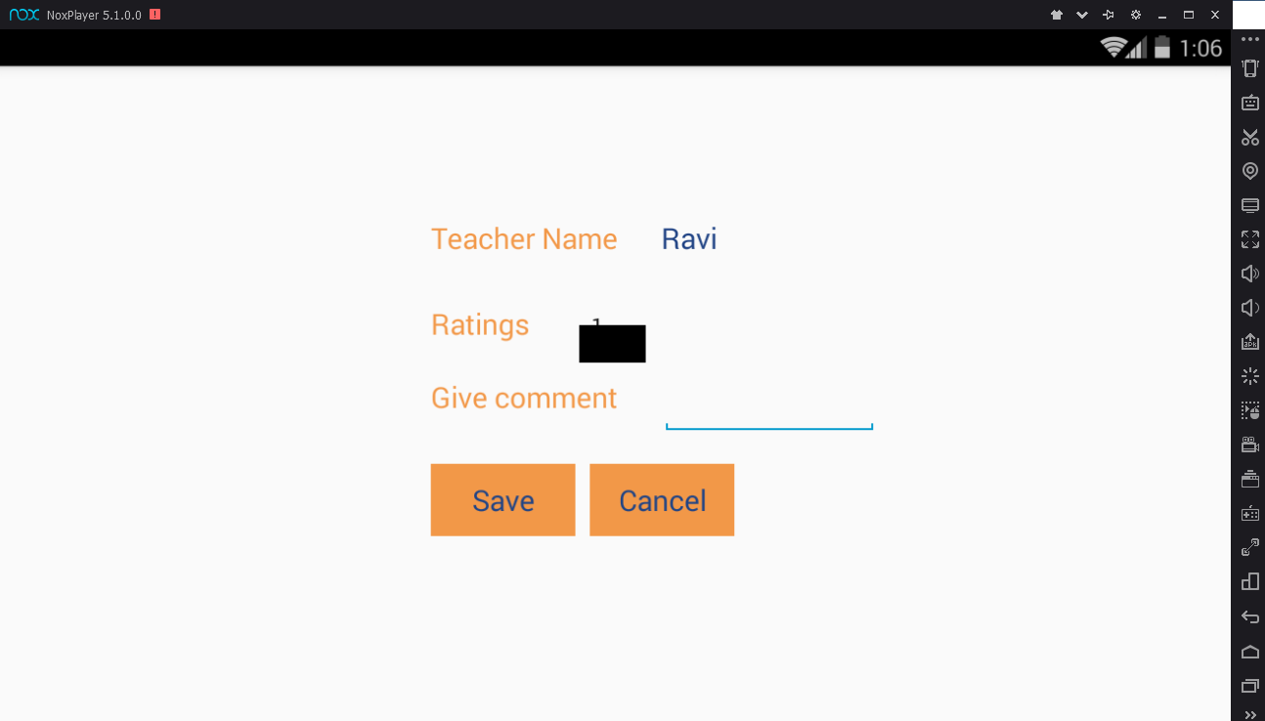
By clicking on a particular teacher name, student can give feedback.

Slide 26
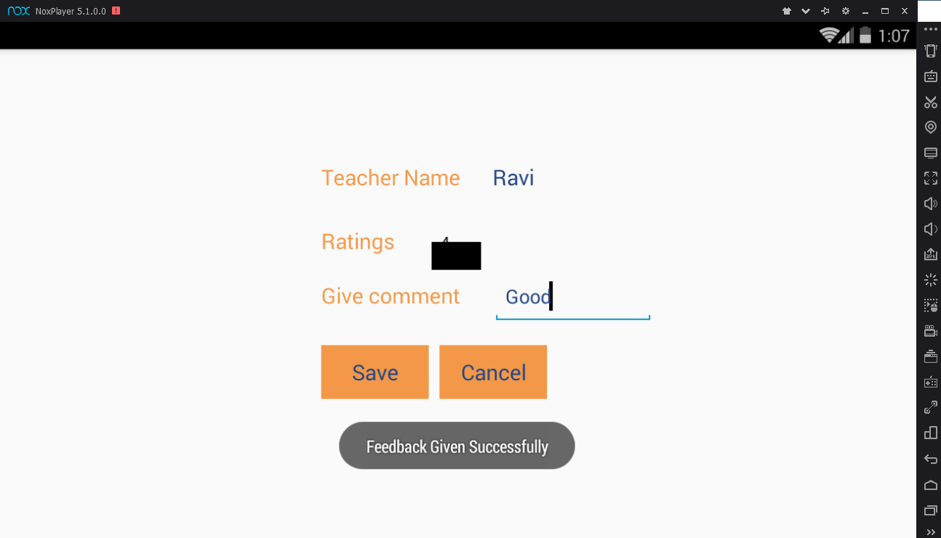
By clicking save button Feedback is sucessfully saved in database.

Slide 27
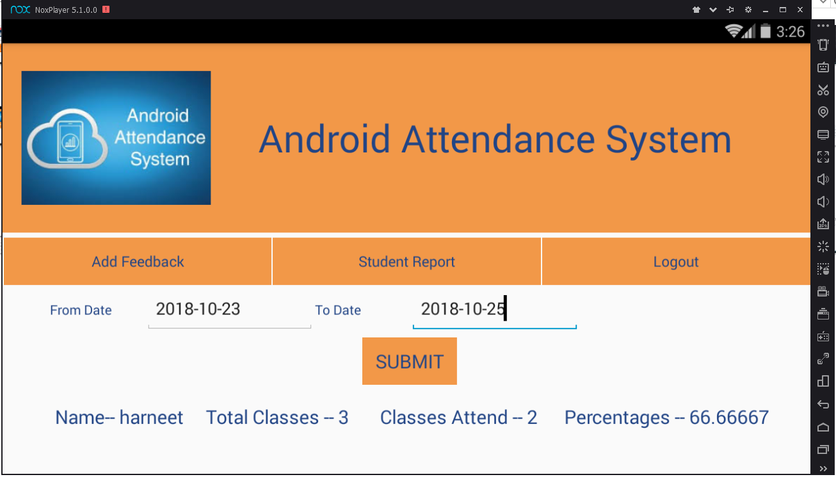
Attendance Check

Slide 28
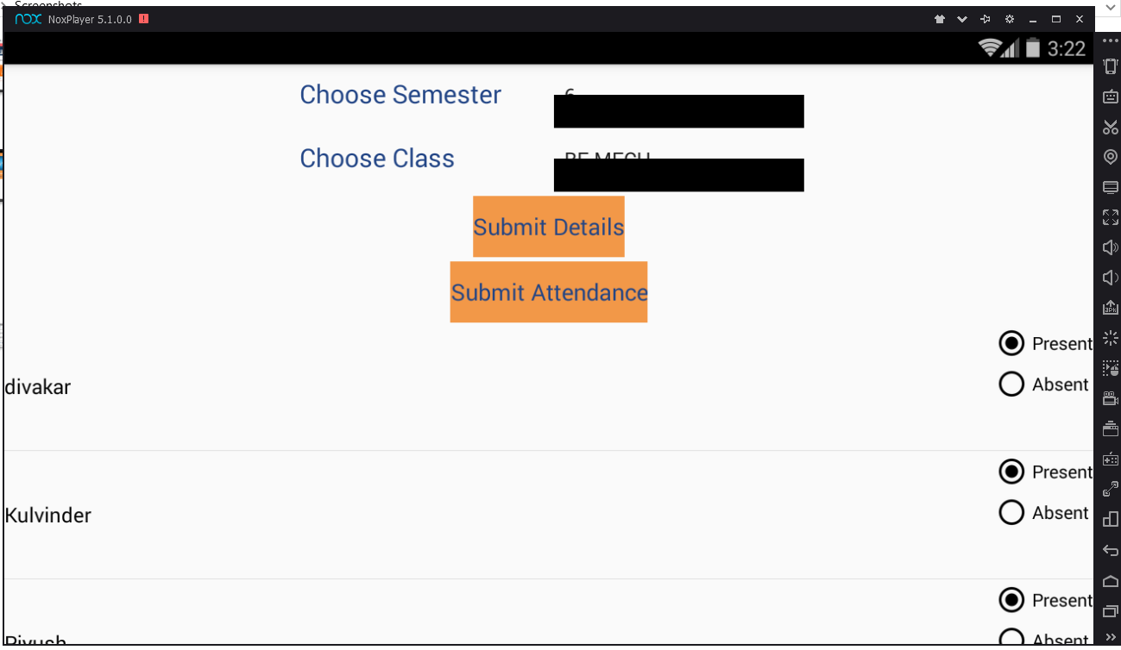
After Teacher Login

Slide 29
Table for Login Activity
S.No. | Field name | Data Type | Description
1. | s_no | integer | Serial Number of Registered Users(Used as Primary Key)
2. | name | varchar | Name of User
3. | user_id | varchar | User Id(used for login)
4. | user_password | varchar | Password(used for login)
5. | user_type | varchar | Specifies whether user is Admin or Teacher or Student.

Slide 30
Table for Student details
S.No | Field name | Data Type | Description
1. | student_id | integer | Unique key for Every Student.
2. | student_name | varchar | Name of student.
3. | user_name | varchar | User name(used for login)
4. | password | varchar | Password(used for login)
5. | class | varchar | The course in which the students are enrolled
6. | phone | varchar | Phone no. of student.
7. | student_email_id | varchar | Email id of student.
8. | semester | integer | The semester in which Students are Studying

Slide 31
Table for Student Attendance
S.No. | Field name | Data Type | Description
1. | sno | integer | Serial Number of Students
2. | s_name | varchar | Student Name
3. | attendance | varchar | Species whether student is present or absent.
4. | date | date | The Date at which attendance is taken.
5. | took_by | varchar | The Teacher who took the attendance.
6. | semester | integer | The semester in which Students are Studying.
7. | class | varchar | The course in which the students are enrolled .

Slide 32
Table For Class Details
S.No. | Field name | Data Type | Description
1. | class_id | integer | This is used as a Primary Key
2. | course_name | varchar | This is the name of Teacher.
3. | semester | integer | This is the semester in which Students are Studying.
4. | teacher | varchar | This is the name of the Teacher

Slide 33
Table for Teacher details
S.No. | Field name | Data Type | Description
1. | teacher_id | integer | Primary Key for teacher
2. | teacher_name | varchar | Name of teacher
3. | user_name | varchar | User name(used for login)
4. | password | varchar | Password(used for login)
5. | teacher_mobileno. | integer | Mobile no. of teacher
6. | teacher_emailid | varchar | Email id of teacher.
7. | teacher_heighestqualificatn | varchar | Highest qualification of teacher.

Slide 34
Advantages
1. Reduce paperwork and save time and money with mobile and cloud-based attendance management system
2. Eliminate duplicate data entry and errors in time and attendance entries
3. Improve visibility to track and manage student attendance & absenteeism across multiple campuses
4. Automatic calculation of leave and reward points accrued
5. Track the attendance of teachers and staff, assign work and manage allocation
6. Auto-generate various types of reports of class or student attendance
7. Increased security and confidentiality with role-based permissions to users

Slide 35
THANKYOU

